Slide 1
SI 618: Large-scale distributed computation 2
Fall 2022
Instructor: Ceren Budak

Slide 2
Before we get started… Projects
Project proposal purpose and expectations:
Purpose: We want to make sure you have *a* plan for a project. This can change, if needed. (And indeed, we will tell you if it should)
Expectations: You don’t know spark yet. How can you know whether the task you are considering can be accomplished using spark/sparksql?
If you can see a way with mrjob, you can do it with spark
Most analyses you can imagine running using sql or python dataframes can be run using spark/sparksql but at a larger scale. Feel free to suggest an analysis and we will let you know if it is not possible (you won’t lose points for this)
Mostly, focus on the higher level goals for analysis. We want to make sure you have good datasets and a good first idea of a set of questions you would like to answer using them.

Slide 3
This week
Spark
Great Lakes
Advanced Spark Example

Slide 4
Spark - Fast and general engine for large-scale data processing
Up to 100 times faster than Hadoop MapReduce
Written in Scala, providing Scala, Java and Python APIs
Supports both batch mode and real-time data stream processing
Write once, run everywhere
Spark runs on Hadoop, Mesos, standalone, or in the cloud. It can access diverse data sources including HDFS, Cassandra, HBase, S3.
http://spark.apache.org/docs/latest/quick-start.html
Sources: https://spark.apache.org, http://en.wikipedia.org/wiki/Apache_Spark

Slide 5
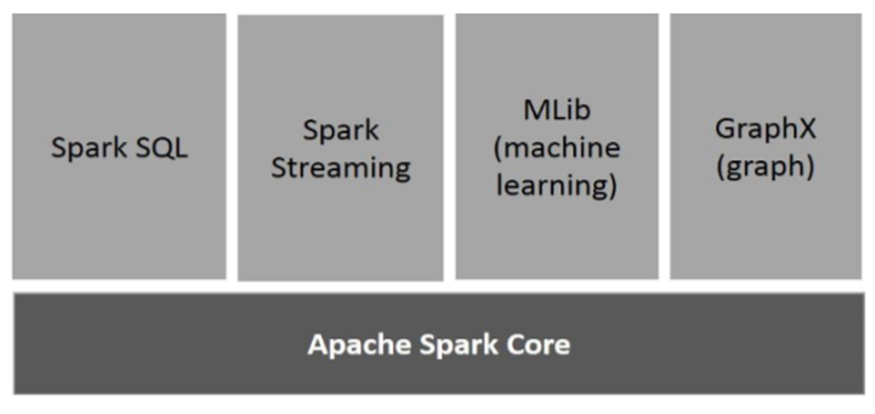
Spark Components
https://www.tutorialspoint.com/apache_spark/apache_spark_introduction.htm
Notes:
Apache Spark Core
Spark Core is the underlying general execution engine for spark platform that all other functionality is built upon. It provides In-Memory computing and referencing datasets in external storage systems.
Spark SQL
Spark SQL is a component on top of Spark Core that introduces a new data abstraction called SchemaRDD, which provides support for structured and semi-structured data.
Spark Streaming
Spark Streaming leverages Spark Core's fast scheduling capability to perform streaming analytics. It ingests data in mini-batches and performs RDD (Resilient Distributed Datasets) transformations on those mini-batches of data.
MLlib (Machine Learning Library)
MLlib is a distributed machine learning framework above Spark because of the distributed memory-based Spark architecture. It is, according to benchmarks, done by the MLlib developers against the Alternating Least Squares (ALS) implementations. Spark MLlib is nine times as fast as the Hadoop disk-based version of Apache Mahout (before Mahout gained a Spark interface).
GraphX
GraphX is a distributed graph-processing framework on top of Spark. It provides an API for expressing graph computation that can model the user-defined graphs by using Pregel abstraction API. It also provides an optimized runtime for this abstraction.

Slide 6
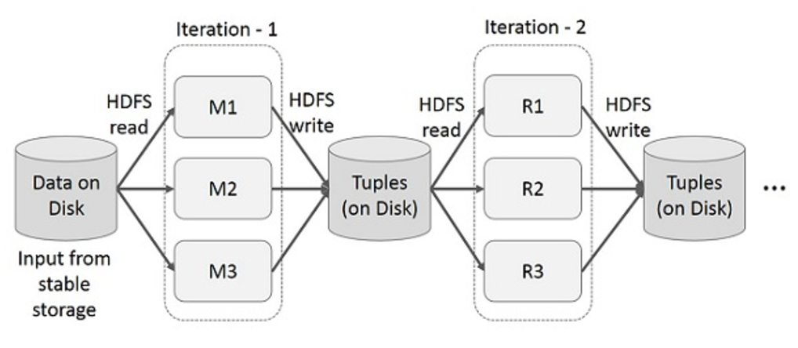
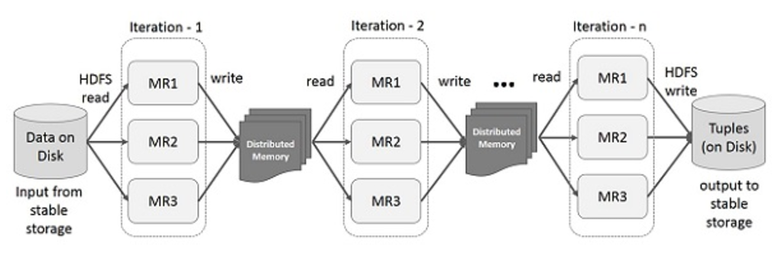
Traditional MapReduce vs. Spark: iterative operations
MapReduce
Spark
https://www.tutorialspoint.com/apache_spark/apache_spark_introduction.htm

Slide 7
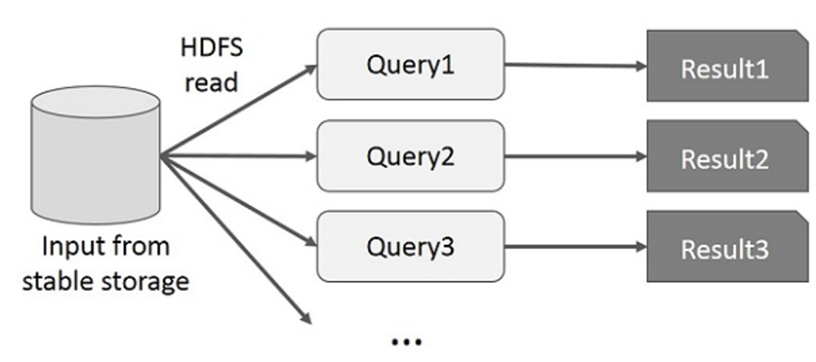
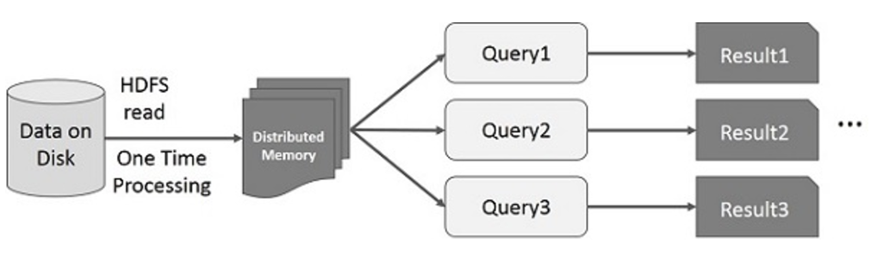
Traditional MapReduce vs. Spark: interactive operations
MapReduce
Spark
https://www.tutorialspoint.com/apache_spark/apache_spark_introduction.htm

Slide 8
Basic Spark Concepts
SparkContext
represents the connection to a Spark cluster, and can be used to create RDDs, accumulators and broadcast variables on that cluster.
Resilient Distributed Dataset (RDD)
RDDs have actions, which return values,
and transformations, which return new RDDs
Two code execution modes:
Interactive Python shell: PySpark
Running standalone applications: spark-submit
Notes:
Broadcast variables − used to efficiently, distribute large values.
Accumulators − used to aggregate the information of particular collection.
Broadcast variables allow the programmer to keep a read-only variable cached on each machine rather than shipping a copy of it with tasks. They can be used, for example, to give every node, a copy of a large input dataset, in an efficient manner. Spark also attempts to distribute broadcast variables using efficient broadcast algorithms to reduce communication cost.
Spark actions are executed through a set of stages, separated by distributed “shuffle” operations. Spark automatically broadcasts the common data needed by tasks within each stage.
The data broadcasted this way is cached in serialized form and is deserialized before running each task. This means that explicitly creating broadcast variables, is only useful when tasks across multiple stages need the same data or when caching the data in deserialized form is important.
Broadcast variables are created from a variable v by calling SparkContext.broadcast(v). The broadcast variable is a wrapper around v, and its value can be accessed by calling the value method. The code given below shows this −
scala> val broadcastVar = sc.broadcast(Array(1, 2, 3))
Accumulators are variables that are only “added” to through an associative operation and can therefore, be efficiently supported in parallel. They can be used to implement counters (as in MapReduce) or sums. Spark natively supports accumulators of numeric types, and programmers can add support for new types. If accumulators are created with a name, they will be displayed in Spark’s UI. This can be useful for understanding the progress of running stages (NOTE − this is not yet supported in Python).
An accumulator is created from an initial value v by calling SparkContext.accumulator(v). Tasks running on the cluster can then add to it using the add method or the += operator (in Scala and Python). However, they cannot read its value. Only the driver program can read the accumulator’s value, using its value method.

Slide 9
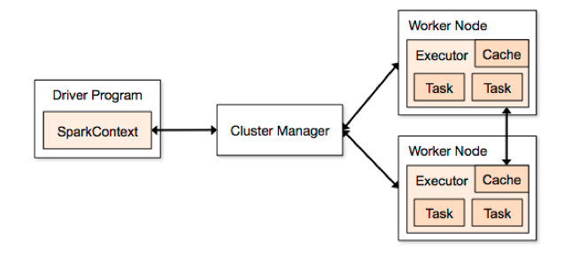
SparkContext
Represents a connection to a computing cluster
In PySpark, a SparkContext is auto-created for you in a variable called sc
Source: https://spark.apache.org/docs/1.1.1/cluster-overview.html

Slide 10
Resilient Distributed Dataset (RDD)
The fundamental abstraction for distributed data computation
An RDD is:
A immutable (read-only) collection of items
Partitioned across computing nodes
That can be manipulated in parallel
Once you have a SparkContext you can create RDDs
Example: A collection of lines from a text file
>>> lines = sc.textFile("input.txt") # Create an RDD called lines, input needs to be on HDFS
>>> lines.count() # Count the number of items in this RDD
3
>>> lines.first() # First item in this RDD, i.e. first line of input.txt
u'summer school 2012 in indiana'

Slide 11
In Spark, all work involves one of three kinds of operations on RDDs
Creating new RDDs
e.g. lines = sc.textFile("input.txt")
Input: various. Output: new RDD
2. Transforming existing RDDs
e.g. pigLines = lines.filter(lambda line: "pig" in line)
Input: one or more RDDs. Output: new RDD
3. Computing actions on RDDs to get a result
e.g. pigLines.first()
Input: one or more RDDs. Output: various non-RDD

Slide 12
Three kinds of operations on RDDs
Creating new RDDs
e.g. lines = sc.textFile("input.txt")
Input: various. Output: new RDD
2. Transforming existing RDDs
e.g. pigLines = lines.filter(lambda line: "pig" in line)
Input: one or more RDDs. Output: new RDD
3. Computing actions on RDDs to get a result
e.g. pigLines.first()
Input: one or more RDDs. Output: various non-RDD

Slide 13
Creation methods
Load data from external storage
lines = sc.textFile('./nyt/1985.txt’)
Parallelize an existing data structure
lines = sc.parallelize(["pandas", "i like pandas"])

Slide 14
Three kinds of operations on RDDs
Creating new RDDs
e.g. lines = sc.textFile("input.txt")
Input: various. Output: new RDD
2. Transforming existing RDDs
e.g. pigLines = lines.filter(lambda line: "pig" in line)
Input: one or more RDDs. Output: new RDD
3. Computing actions on RDDs to get a result
e.g. pigLines.first()
Input: one or more RDDs. Output: various non-RDD

Slide 15
Element-wise transformations: map and filter
The map() transformation takes in a function and applies it to each element in the RDD with the result of the function being the new value of each element in the resulting RDD.
nums = sc.parallelize([1, 2, 3, 4])
squared = nums.map(lambda x: x * x).collect()
for num in squared:
print "%i " % (num)
The magic of Spark: operations like ‘map’ are parallelized across the cluster.
Notes:
To print all elements on the driver, one can use the collect() method to first bring the RDD to the driver node

Slide 16
Digression: Lambda Function
nums = sc.parallelize([1, 2, 3, 4])
squared = nums.map(lambda x: x * x).collect()
for num in squared:
print "%i " % (num)
You can create anonymous functions in Python using lambda. For instance instead of:
You can have
You also do not have to assign lambda function to a variable:
1 2 | def multiply(x, y): return x * y
1 2 | r = lambda x, y: x * y r(12, 3) # call the lambda function
1 | (lambda x, y: x * y)(3,4)

Slide 17
Element-wise transformations: map and filter
The filter() transformation takes in a function and returns an RDD that only has elements that pass the filter() function.
pigLines = lines.filter(lambda line: "pig" in line)
Or
def containsError(s):
return "error" in s
word = rdd.filter(containsError)

Slide 18
Element-wise transformations: flatMap
Sometimes we want to produce multiple output elements for each input element. The operation to do this is called flatMap(). As with map(), the function we provide to flatMap() is called individually for each element in our input RDD. Instead of returning a single element, we return an iterator with our return values. Rather than producing an RDD of iterators, we get back an RDD that consists of the elements from all of the iterators.
lines = sc.parallelize(["hello world", "hi"])
words = lines.flatMap(lambda line: line.split(" "))
words.first() # returns "hello"

Slide 19
Set-like transformations
errorsRDD = inputRDD.filter(lambda x: "error" in x)
warningsRDD = inputRDD.filter(lambda x: "warning" in x)
badLinesRDD = errorsRDD.union(warningsRDD)
rdd1.union(rdd2)
rdd1.intersection(rdd2)
rdd1.subtract(rdd2)
rdd1.distinct()

Slide 20
Pair RDDs: collections of (key, value) pairs
reduceByKey(func)
sortByKey()
groupByKey()
mapValues(func)
flatMapValues(func)
keys()
values()

Slide 21
Pair RDDs: sortByKey()
Just like the Python sorted() function: sort (key, value) pairs alphabetically
word_counts_sorted = word_counts.sortByKey()

Slide 22
Pair RDDs: sortBy()
Just like the Python sorted() using a key= function
word_counts_sorted = word_count3.sortBy(lambda x: x[1], ascending = False)

Slide 23
Pair RDDs: reduceByKey(func)
Takes a function that operates on the values of two elements with the same key and returns a new RDD.
sumRDD = rdd.reduceByKey(lambda x, y: x + y)

Slide 24
Pair RDDs: reduce(func)
Reduce is an action that aggregates all the elements of the RDD using some function and returns the final result to the driver program
sumRDD = rdd.reduce(lambda x, y: x + y)
Notes:
reduce must pull the entire dataset down into a single location because it is reducing to one final value. reduceByKey on the other hand is one value for each key.

Slide 25
Three kinds of operations on RDDs
Creating new RDDs
e.g. lines = sc.textFile("input.txt")
Input: various. Output: new RDD
2. Transforming existing RDDs
e.g. pigLines = lines.filter(lambda line: "pig" in line)
Input: one or more RDDs. Output: new RDD
3. Computing actions on RDDs to get a result
e.g. pigLines.first()
Input: one or more RDDs. Output: various non-RDD

Slide 26
Actions
take(n) Gets the first k elements
for line in lines.take(10):
print line
collect() Gets all elements
Take an RDD and turn it into a local list
Be careful when using on a large RDD
first() Gets the first element
These operations create non-RDD objects. Be careful not to apply before you need to (it will take a while)

Slide 27
RDD operations we have learned:
map(f, preservesPartitioning=False)
flatMap(f, preservesPartitioning=False)
filter(f)
sortBy(keyfunc, ascending=True, numPartitions=None)
reduceByKey(func, numPartitions=None)
take(num)
collect()
saveAsTextFile(path, compressionCodecClass=None)

Slide 28
More about Spark
Basic statistic of RDDs:
max(key=None)
min(key=None)
mean()
count()
sum()
stdev()
How to join RDDs:
join(other, numPartitions=None)
leftOuterJoin(other, numPartitions=None)
rightOuterJoin(other, numPartitions=None)
fullOuterJoin(other, numPartitions=None)
https://spark.apache.org/docs/1.3.0/api/python/pyspark.html#pyspark.RDD

Slide 29
Poll/Quiz
We want to process an RDD where entries are lines and create a new RDD where entries are words. How do we do this?
Go to PollEv.com/cerenbudak421

Slide 30
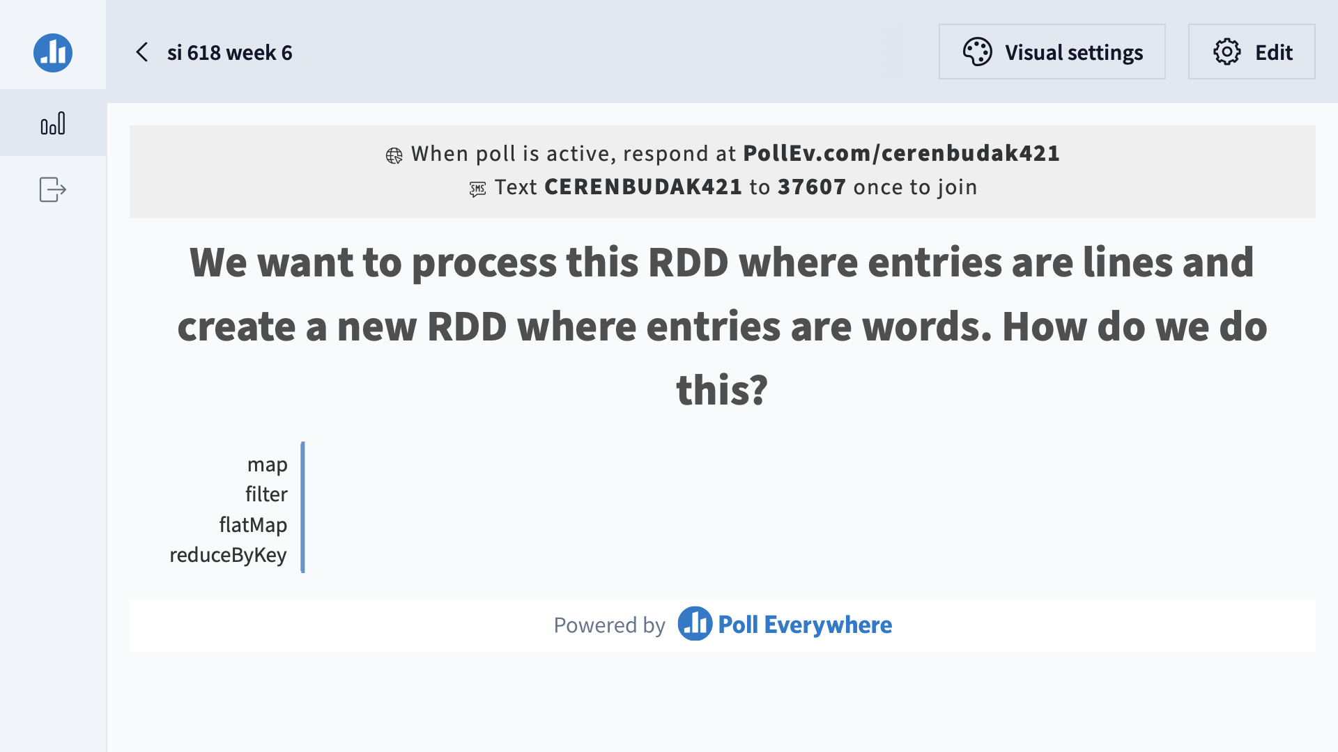

Slide 31
Poll/Quiz
We want to aggregate over all values of the same key (word) to count them. How do we do that?
Go to PollEv.com/cerenbudak421

Slide 32
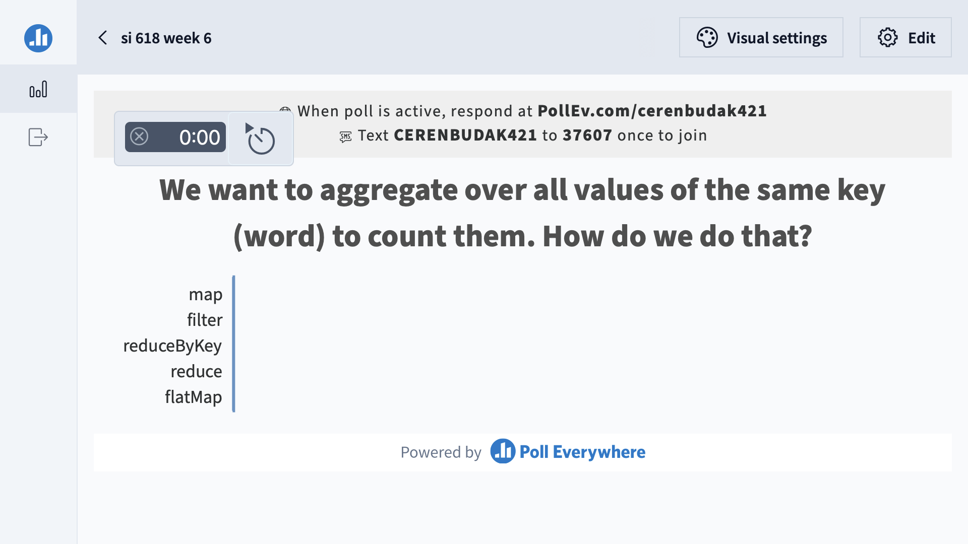

Slide 33
Resources
Spark Documentation
https://spark.apache.org/docs/latest/quick-start.html
https://spark.apache.org/docs/latest/programming-guide.html
https://spark.apache.org/docs/latest/api/python/index.html
Spark on Great Lakes
https://github.com/umich-arc/spark-on-hpc

Slide 34
Spark Example 1: Word Count Let’s work on it together!

Slide 35
Great Lakes
Great Lakes is a campus wide cluster of 13,000 compute cores that serves a diverse set of large-scale computation needs (including standard machines, GPUs and large memory machines)
Available to all researchers on campus for simulation, modeling, machine learning, data science, genomics, and more
ARC-TS provides various other computing solutions. Check out: https://arc-ts.umich.edu/systems-services/ for more info.
We will use the Great Lakes cluster in this class. For the user guide, please check: https://arc.umich.edu/greatlakes/user-guide/

Slide 36
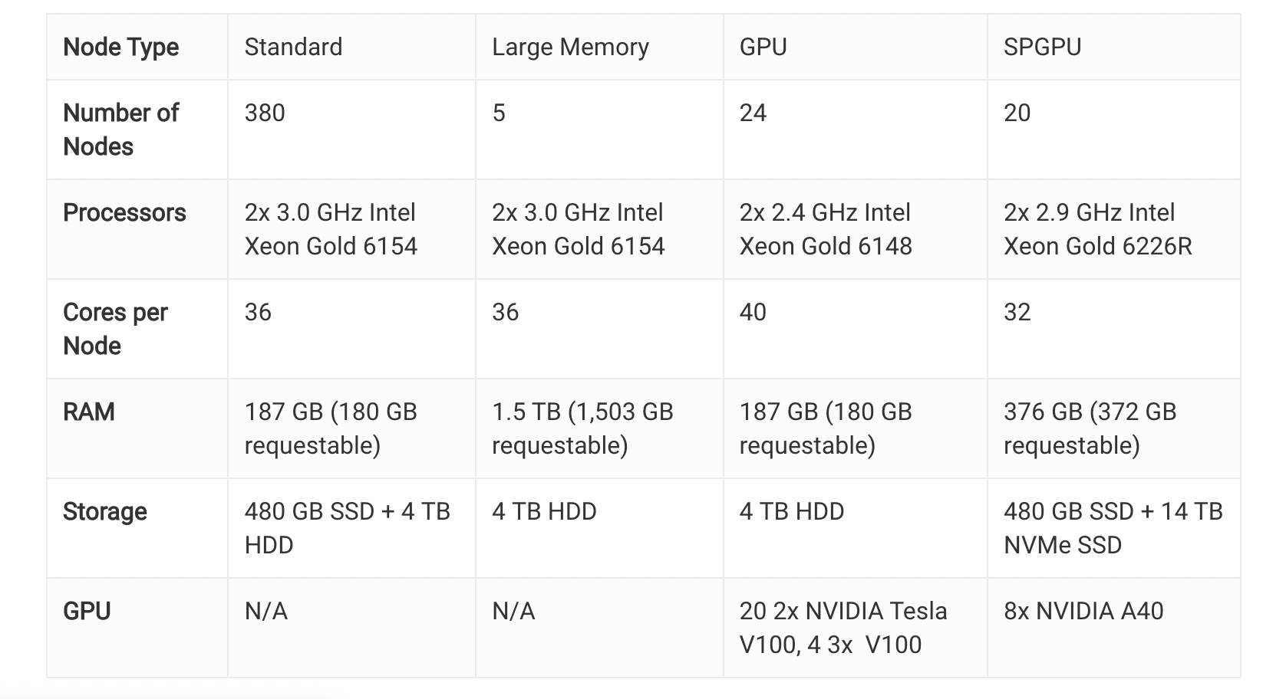
Great Lakes
InfiniBand HDR100 networking, capable of 100 Gb/s throughput. 25 Gb/s ethernet for the login and transfer nodes.
The high-speed scratch file system provides 2 petabytes of storage at approximately 80 GB/s performance.
Operated through Slurm workload manager
Software available through modules and installed on the home directory
We will use the standard machines in this class but you can check out other resources available as well

Slide 37
Great Lakes Training Videos
Great Lakes provides a rich environment for different large-scale computation solutions. In this class, we will cover Spark but there are many other alternatives. Check out their training videos: https://www.mivideo.it.umich.edu/channel/ARC-TS%2BTraining/181860561/ (great lakes homepage has the pointer to this page under ”training and workshops”)
Many useful training videos on there. I will highlight two:
Machine Learning for Great Lakes
Getting Started with the Python Multiprocessing Package

Slide 38
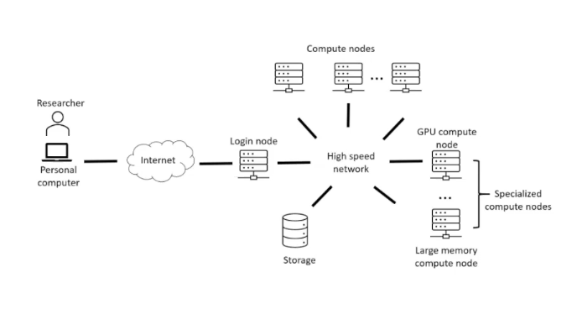
Overview of the Environment
Three main components:
Compute: Software is run on servers
Network: Servers are connected to allow for large-scale computation
Storage: Where data and output are stored

Slide 39
Running Jobs on Great Lakes
Two ways
Interactive mode (interactively write PySpark code using Jupyter notebooks)
Batch mode (submit your .py code to be executed)

Slide 40
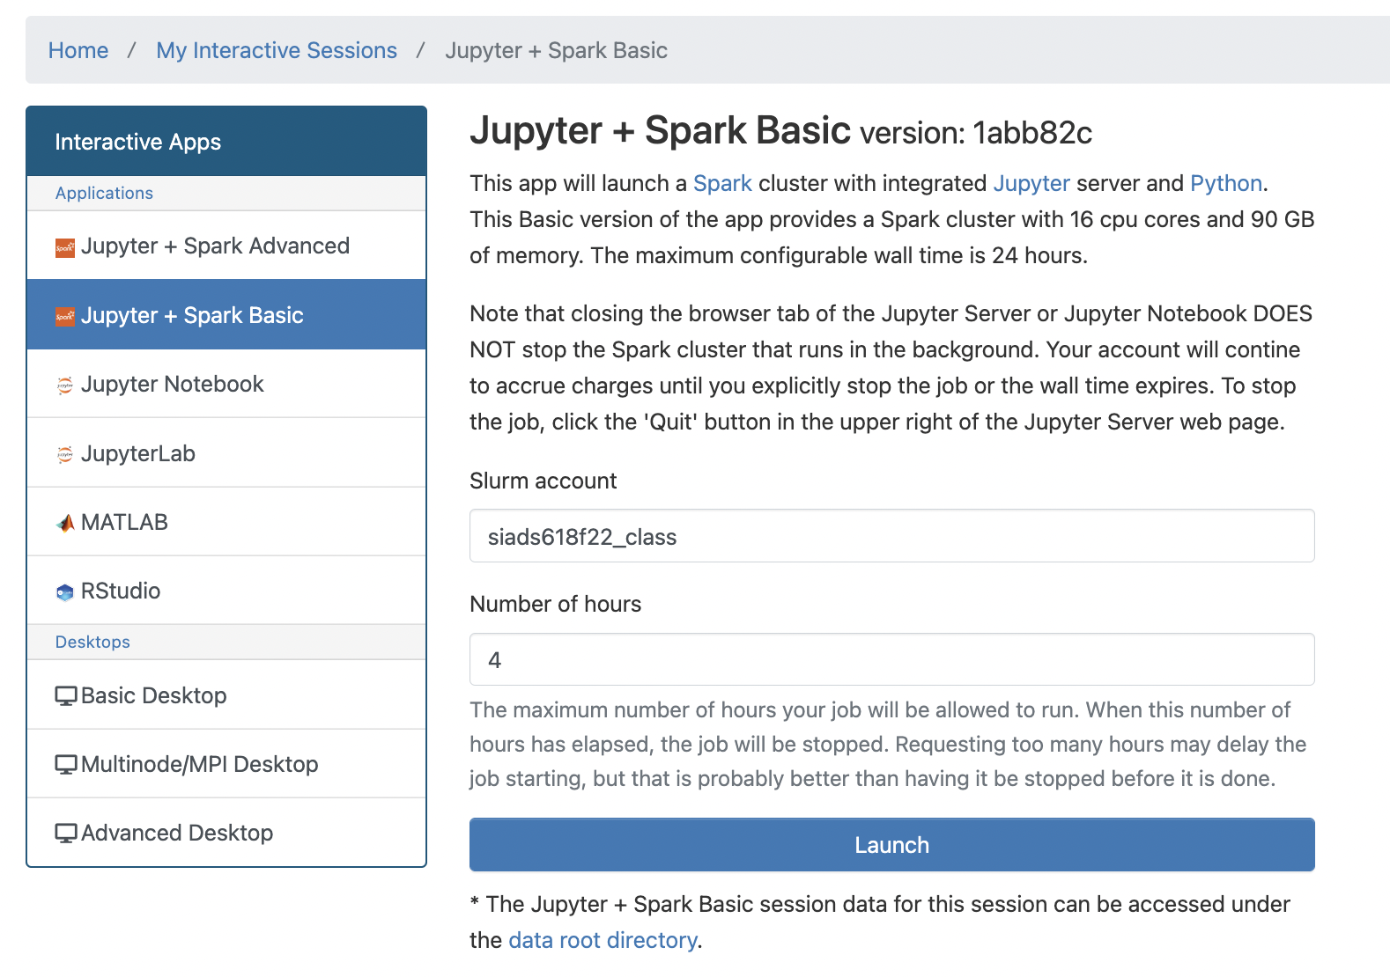
Interactive Spark + Jupyter Notebook
Connect to VPN*. Go to great lakes dashboard: https://greatlakes.arc-ts.umich.edu/pun/sys/dashboard/
Interactive Apps > Jupyter + Spark Basic
Class slurm account
The right balance of
Not wasting resources/leading to longer delay to satisfy the resource requirements
The consequences of underestimating the required time
*See http://www.itcom.itd.umich.edu/vpn/ for details on how to install VPN software for UM.

Slide 41
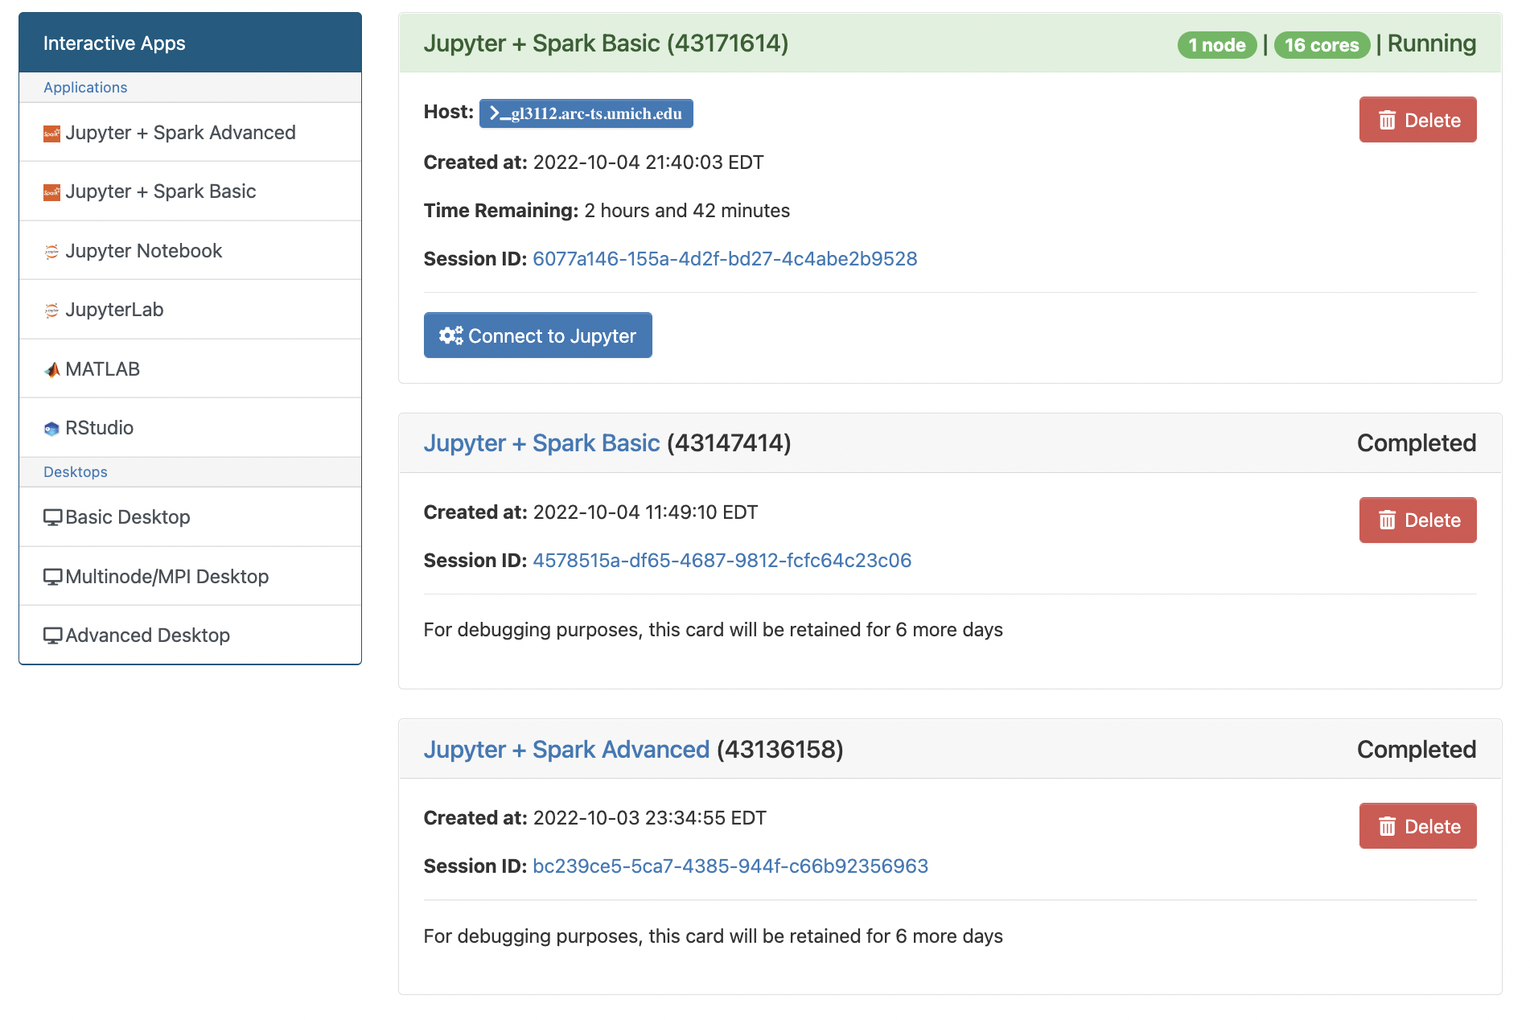
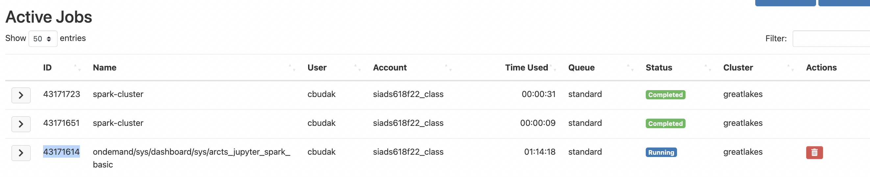
Active and recently completed apps
Apps view

Slide 42
Spark Example 1: Word Count Let’s work on it together!

Slide 43
Running Jobs on Great Lakes
Two ways
Interactive mode (interactively write PySpark code using Jupyter notebooks)
Batch mode (submit your .py code to be executed)

Slide 44
Running Jobs on Batch Mode
Job - Computational work that needs to be completed
Computer program written by you
Steps to run a job
Connect to VPN

Slide 45
Running Jobs on Batch Mode
Job - Computational work that needs to be completed
Computer program written by you
Steps to run a job
Connect to VPN
Connect to the cluster from your personal computer

Slide 46
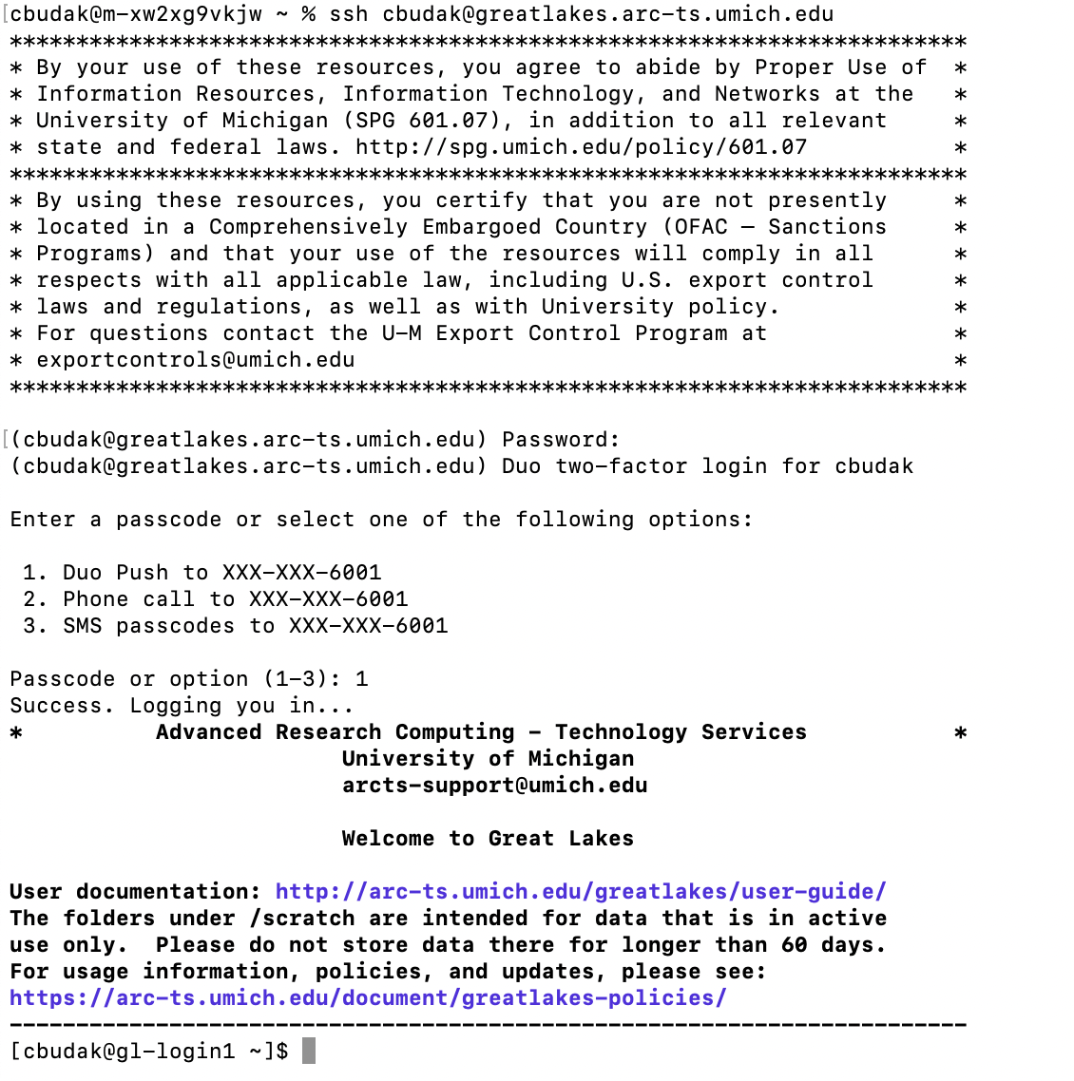
Logging in to remote server
You can also use software such as Putty (on Windows machines).

Slide 47
Running Jobs on Batch Mode
Job - Computational work that needs to be completed
Computer program written by you
Steps to run a job
Connect to VPN
Connect to the cluster from your personal computer
Create a file that contains the program you would like to run
Can be a .py file, or .R etc. In your case this will be a .py file

Slide 48
Working on a remote server: copying files between your laptop and the remote account
Option 1: Use scp
Copy from local to server:
scp localfile uniqname@greatlakes.arc-ts.umich.edu:remotefile (copy a file)
scp -r localdir uniqname@greatlakes.arc-ts.umich.edu:remotedir (copy an entire directory)
Copy from server to local
scp uniqname@greatlakes.arc-ts.umich.edu:remotefile localfile
Option 2: Use CyberDuck (on Mac) or WinSCP (on Windows)
Note that instead of copying files you can also write the code on the login node itself using commandline editing tools like vim or emacs.

Slide 49
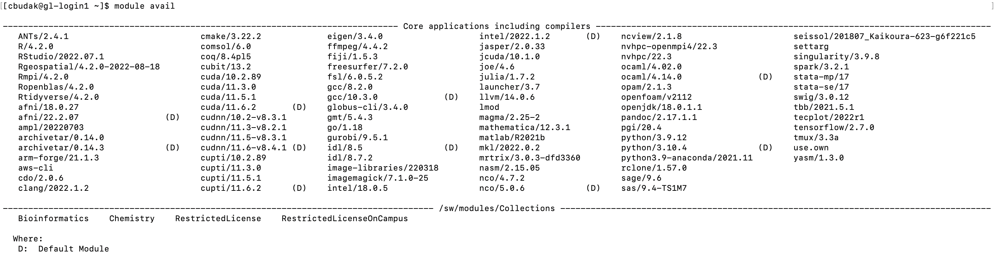
Running Jobs on Batch Mode
Job - Computational work that needs to be completed
Computer program written by you
Steps to run a job
Connect to VPN
Connect to the cluster from your personal computer
Create a file that contains the program you would like to run
Can be a .py file, or .R etc. In your case this will be a .py file
Create a list of modules needed for the program to run
Either listed in the job script (batch mode) or loaded in the current environment

Slide 50
Running Jobs on Batch Mode
Job - Computational work that needs to be completed
Computer program written by you
Steps to run a job
Connect to VPN
Connect to the cluster from your personal computer
Create a file that contains the program you would like to run
Can be a .py file, or .R etc. In your case this will be a .py file
Create a list of modules needed for the program to run
Either listed in the job script (batch mode) or loaded in the current environment
Create a job script
Requests for computational resoruces
Listing of modules
Program to execute
Submit the job script

Slide 51
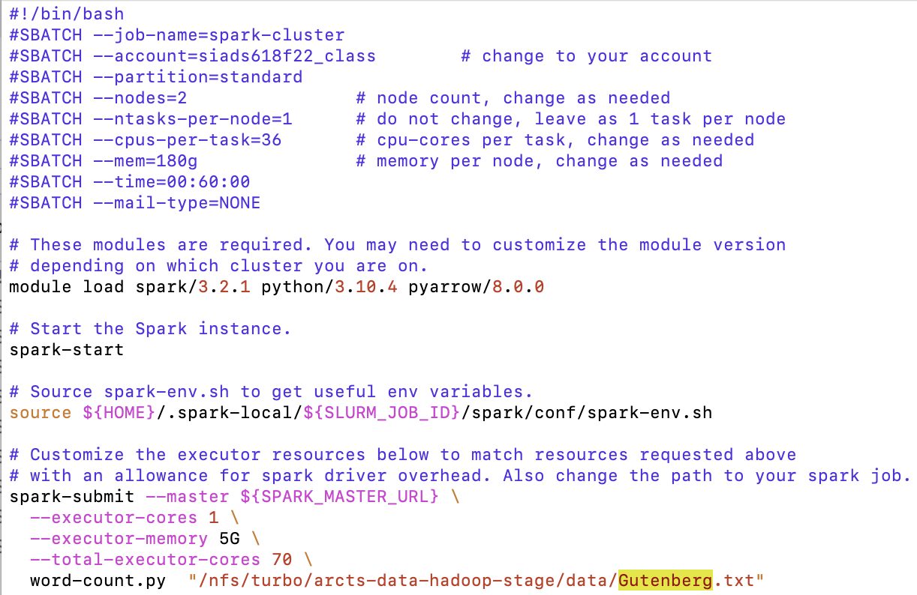
How to write a Job Script
The batch job script is composed of three main components:
The interpreter used to execute the script
#SBATCH directives that convey submission options
The application(s) to execute along with its input arguments and options

Slide 52
Spark Example 1: Word Count We will submit in batch mode together.

Slide 53
Spark Example 2: Yelp Sentiment Analysis
Task: identify words that are indicative of positive or negative reviews
Input: yelp reviews data (https://www.yelp.com/dataset)
Output: A list of most positive and most negative words

Slide 54
How to find positive words
We will compute the following "positivity" score for each word w.
Positivity(w) = log P(w in PositiveReviews) – log P(w in AllReviews)
where P(·) denotes probability
log(x) is the natural logarithm of x.
P(w in PositiveReviews) means the probability that a word occurs, given we are looking at the set of positive reviews.
P(w in AllReviews) means the probability of a word occurring, given that we are looking at all words
This methodology is referred to as log-likelihood ratio. We would use to determine if the likelihood of w is significantly different in corpus (positive reviews) compared to background corpus (all reviews).
We can use the same formula to find negative words

Slide 55
Finding positive words
Say, ‘awesome’ appears 10 times in positive reviews, and all positive reviews together contain 10000 words. Furthermore, say, ‘awesome’ appears 20 times in all reviews, and there are 100000 words in all reviews, Then, positivity score of ‘awesome’ is:
Positivity(awesome) = log P(awesome in PositiveReviews) – log P(awesome in AllReviews) = log(0.001) – log(0.0002) = -6.9 – (-8.51) = 1.61
Words that are more neutral, like ‘the’, that have similar probability given a positive review compared to any review, should have a positivity score close to zero.
How to define positive reviews (and similarly negative reviews)?

